Slide 1



Cartoonify-image
Team Members: More Narendra Guide: Abdul Aziz md
Tamboli Piyush Master Trainer
Ratva Jayram Edunet Foundation
Patel Harsh
Disclaimer: The content is curated for educational purposes only.

Slide 2
OUTLINE
Abstract
Problem Statement
Aims, Objective & Proposed System/Solution
System Design/Architecture
System Development Approach (Technology Used)
Algorithm & Deployment
Conclusion
Future Scope
References
Video of the Project
Notes:
These are the list of chapters that we are going to cover in these foundation codes. Those are chapter one what are AI and ML? chapter 2 applied Python programming in AI, and chapter 3 is exploratory data analysis for ML.

Slide 3
Abstract
The project, Cartoonify Image AI, is focused on the development of an innovative AI-based application that transforms regular images into cartoon-style illustrations. Utilizing advanced image processing and machine learning techniques, the application can analyze and manipulate images to create fun and customizable cartoon visuals.

Slide 4
Lack of Automation: Current image processing techniques require extensive manual effort and are time-consuming. There is a need for more automated and efficient methods. Limited Creativity: Traditional image editing tools often produce generic, uninspired results. There is a desire for more innovative, expressive, and personalized image transformations Accessibility Challenges: Complex image editing software can be difficult for non-expert users to navigate. There is a need for more user-friendly tools that enable creative expression for a wider audience.
Problem Statement

Slide 5
Aim and Objective
Aim: The aim of this project is to develop an AI-powered cartoonification tool that can transform realistic images into visually appealing cartoon-style illustrations.
Objective: The primary objective is to create an intuitive and user-friendly application that can automatically convert any input image into a stylized cartoon-like output, preserving the essence and key features of the original.

Slide 6
Proposed Solution
AI-Powered Cartoonification
Develop an AI-driven system that can automatically convert any image into a visually engaging, stylized cartoon or comic book illustration.
Machine Learning Algorithms
Advanced machine learning techniques such as generative adversarial networks (GANs) and neural style transfer to learn the artistic patterns and techniques of professional cartoonists.
Intuitive User Interface
Create a user-friendly web application or mobile app that allows users to upload images and instantly transform them into dynamic, cartoon-like visuals.

Slide 7
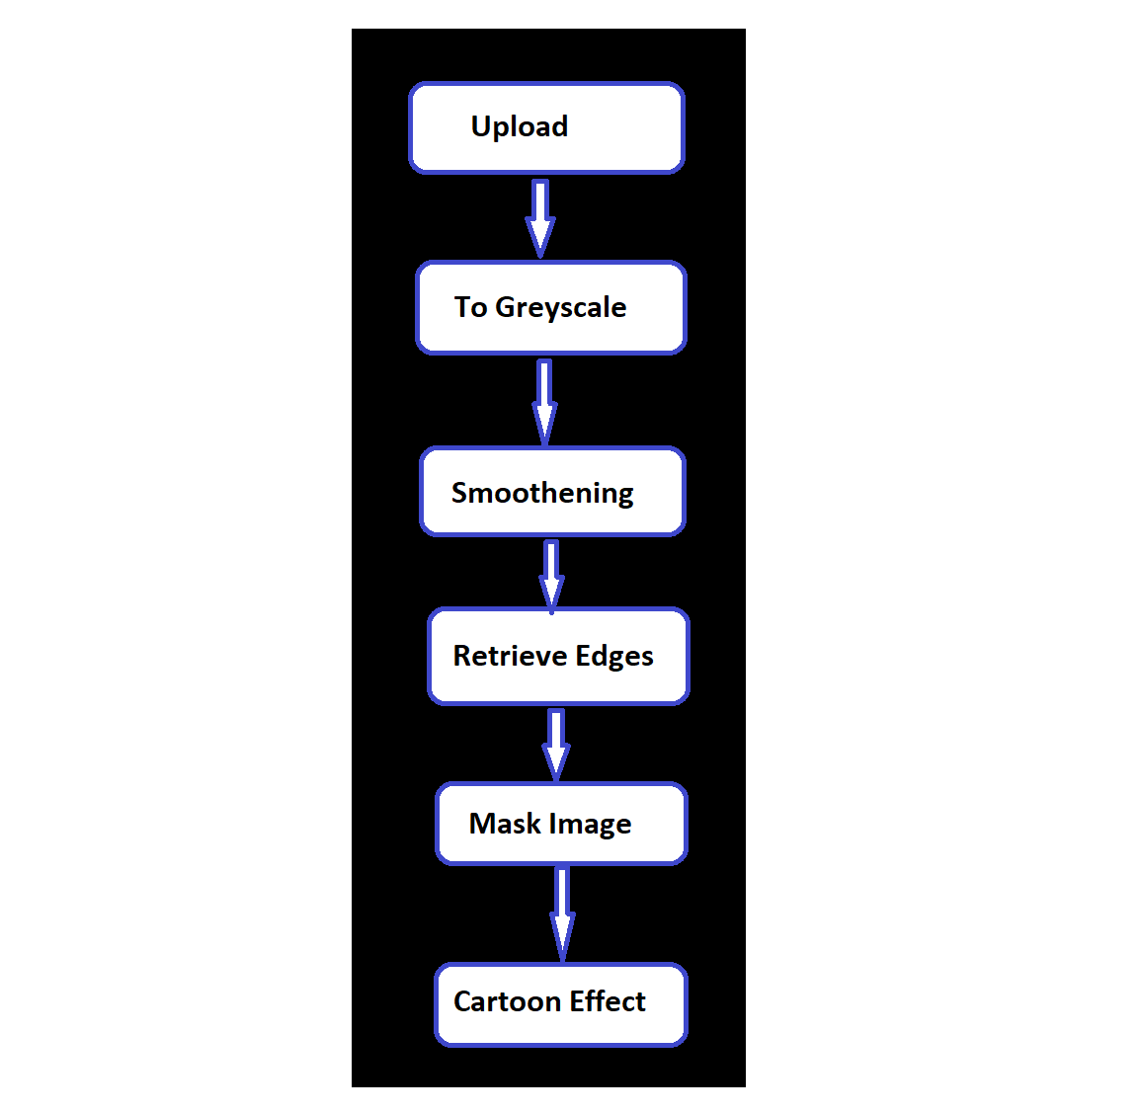
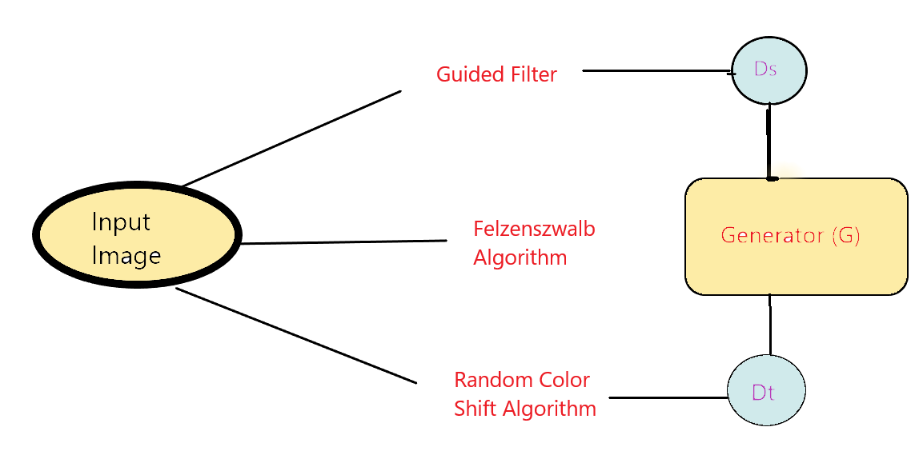
System Architecture

Slide 8
System Deployment Approach
Machine Learning Models
Sophisticated ML algorithms are trained on vast datasets of cartoon-style images, enabling the system to learn the distinct visual characteristics and patterns that define the cartoonification process.
Image Processing
Advanced image processing techniques, such as edge detection, color manipulation, and texture analysis, are employed to deconstruct the original image and reconstruct it in a cartoon-like style.
Neural Networks
Deep neural networks, including Convolutional Neural Networks (CNNs), play a crucial role in the automated feature extraction and style transfer capabilities that power the cartoonification process.

Slide 9
Algorithm & Deployment
Image Capture
The process begins by capturing a digital photo, either from a camera or an existing image file.
Image Analysis
ML algorithms examine the image data, identifying key visual elements like shapes, lines, and colors.
Style Transfer
The system then applies artistic filters and transformations to the image, mimicking the look of hand-drawn cartoons.
Rendering
The final cartoonified image is rendered and displayed to the user, providing a unique and whimsical visual experience.

Slide 10
Conclusion
The Cartoonify Image AI project successfully demonstrates the potential of artificial intelligence and machine learning in transforming regular images into vibrant and customizable cartoon-style illustrations. By providing an intuitive user interface and a range of customization options, the application offers a fun and engaging way for users to reimagine their images.

Slide 11
Future Scope
The Cartoonify Image AI project has a promising future with opportunities for further development and enhancement. Key areas of future scope include:
Style Expansion: Introduce more cartoon styles and artistic effects, giving users a broader range of options to transform their images.
Performance Optimization: Enhance the speed and efficiency of the application to provide a smoother and more responsive user experience.
Integration with Other Platforms: Explore potential collaborations with popular social media platforms and design software to integrate Cartoonify Image AI features.

Slide 12
Reference
https://projectworlds.in/image-to-cartoon-python-opencv-machine-learni/
https://youtu.be/kmdbsEp9xQA?si=UtOKfXL4enAcb9V6
Notes:
Reference
These are the references for this session.
12

Slide 13
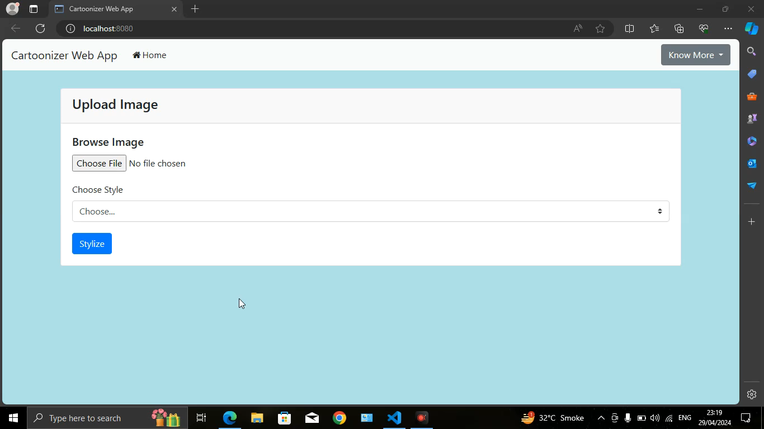

Slide 14
Thank you!
Notes:
thank you very much for joining this PPT, keep learning.
14

